Slide 1



time series
View in Power BI
Last data refresh:
24/12/2023 01:26:13 UTC
Downloaded at:
24/12/2023 01:30:59 UTC

Slide 2
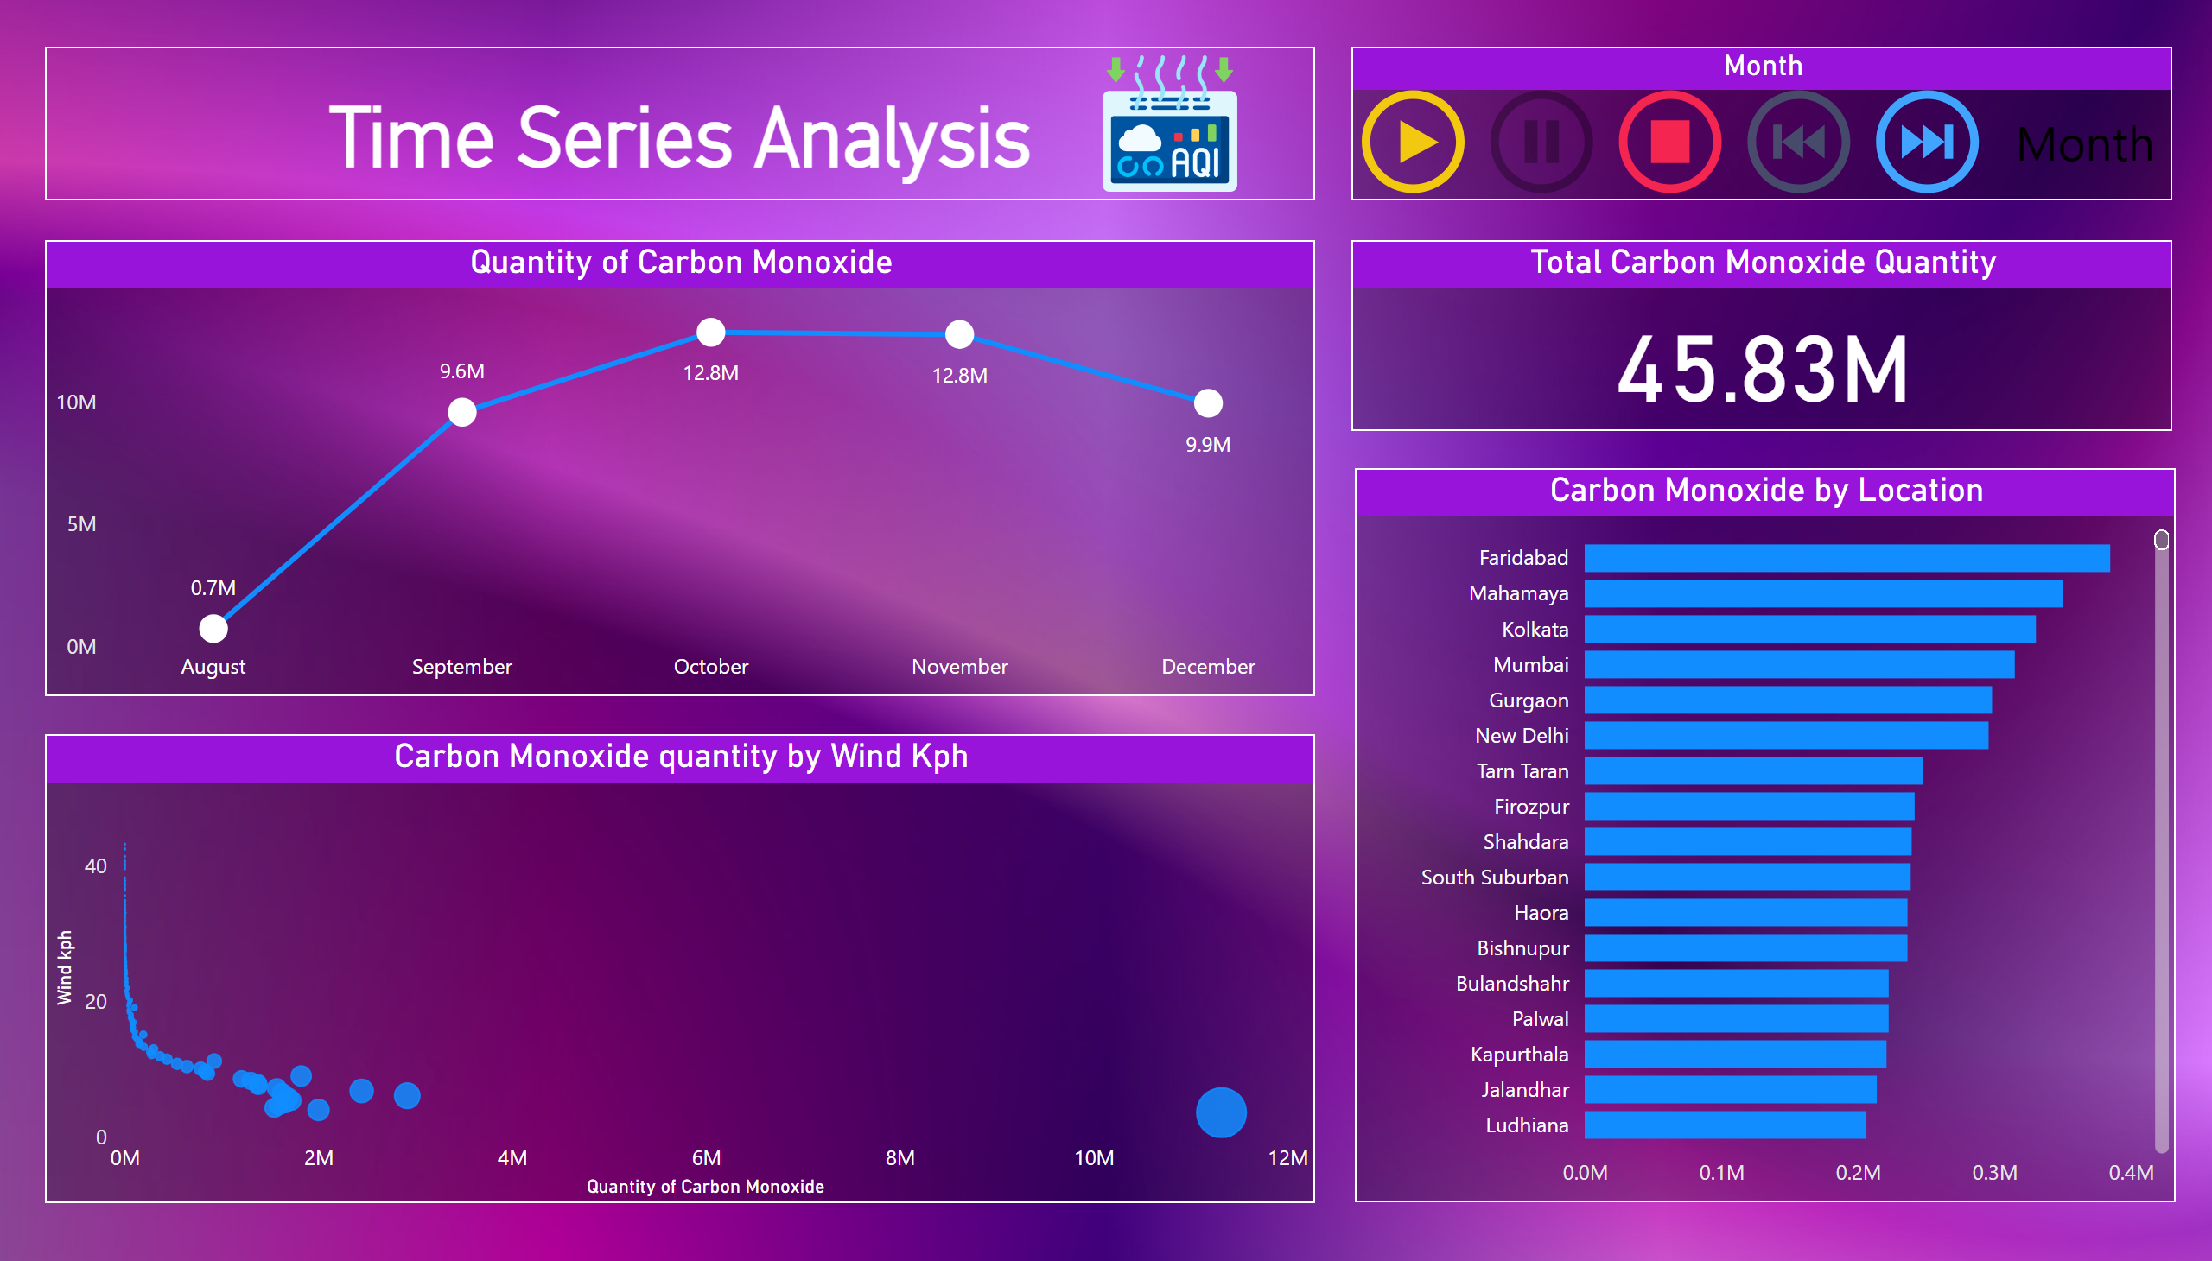
Page 1
Notes:
Carbon Monoxide quantity by Wind Kph
No alt text provided
Carbon Monoxide by Location
No alt text provided
Quantity of Carbon Monoxide
No alt text provided
PBI_CV_16948668_E17D_454B_8664_2F2C470EA8C1
No alt text provided
Total Carbon Monoxide Quantity
No alt text provided
textbox
No alt text provided
image
No alt text provided

